Slide 1


Seoul Bike Sharing Data
Arham Mehdi
Objective: Use linear regression to predict rented bike counts

Slide 2
Variables
Rented Bike Count (Dependent Variable)
Hour of the day
Date (year-month-day)
Temperature (in Celsius)
Humidity (as a percentage)
Wind speed (in m/s)
Visibility (in 10m)
Dew point temperature (in Celsius)
Solar radiation (in MJ/m2)
Rainfall (in mm)
Snowfall (in cm)
Seasons (categorical variable: Winter, Spring, Summer, Autumn)
Holiday (binary categorical variable: Holiday/No holiday)
Functional Day (binary categorical variable: NoFunc/Functioning hours)

Slide 3
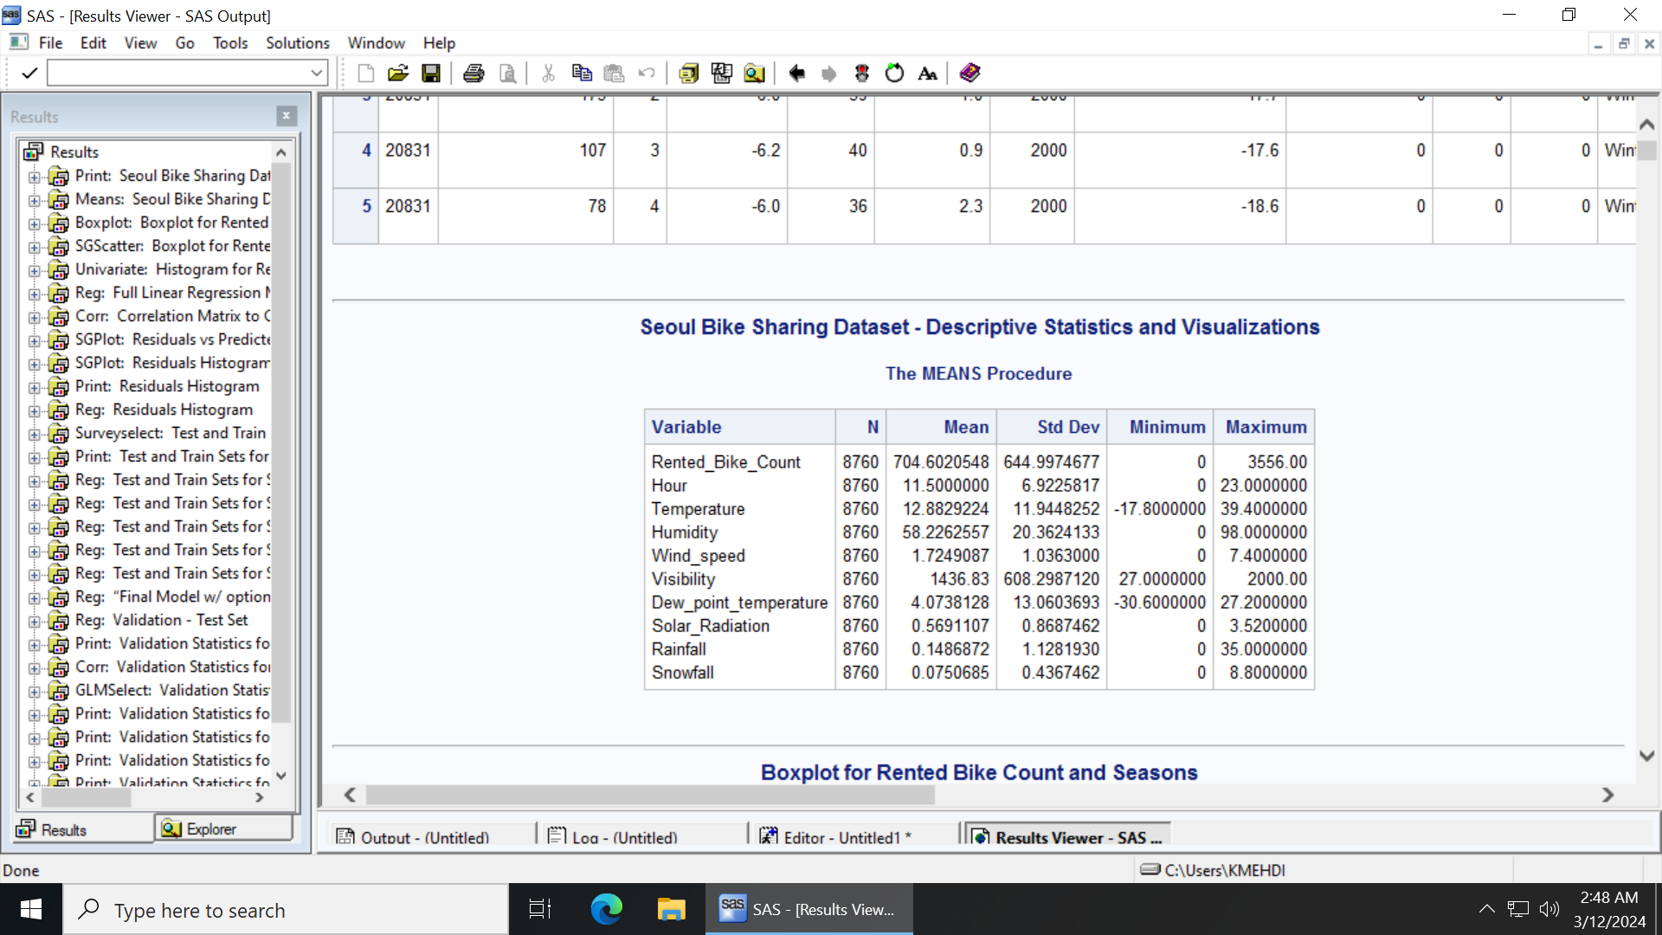
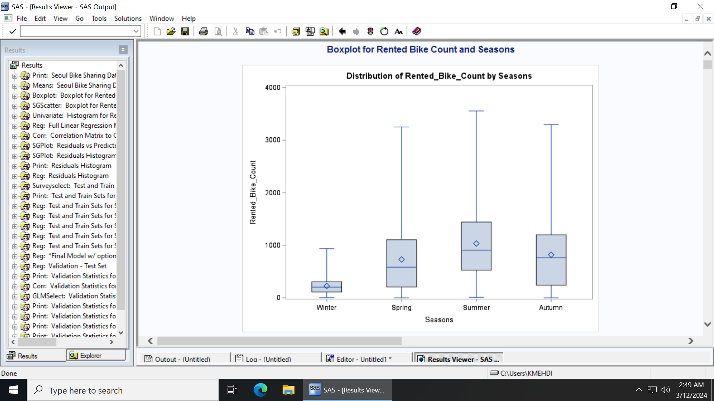
Descriptive Statistics and Boxplot
There are 8760 observations in the dataset.
Descriptive statistics show an average Rented Bike Count of 704.60 with significant daily fluctuations (Std Dev: 644.99).
Boxplot analysis shows seasonal trends, with higher rental counts in Summer and Autumn, suggesting higher rental counts in warmer weather.

Slide 4
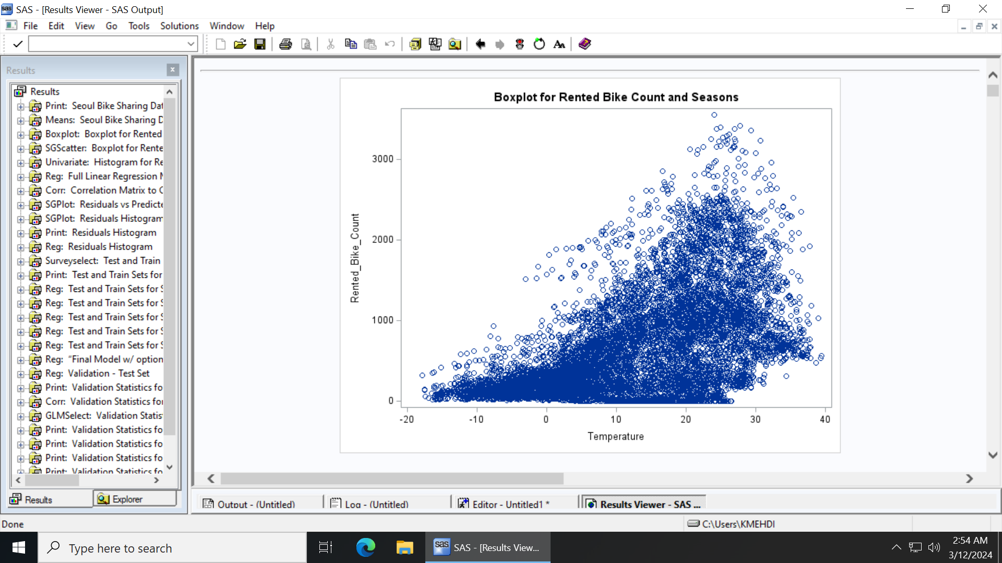
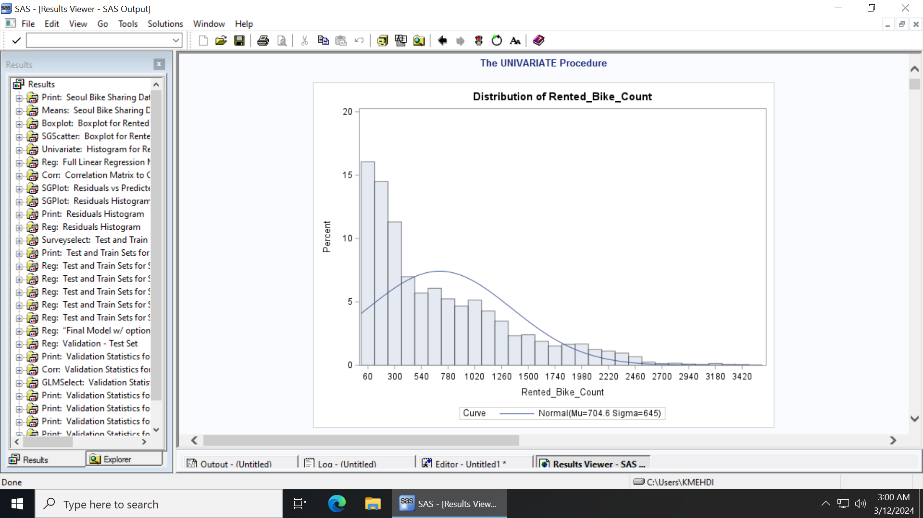
Scatter Plot and Histogram
Scatterplot analysis show a clear positive correlation between Temperature and Rented Bike Count, implying that warmer weather encourages bike rentals.
The pattern indicates increased variance in rentals as temperatures rise, which may suggest other factors also influence rent count during warmer weather, and It makes sense how people wouldn’t want to use public transport during colder weather
This histogram likely indicates that there are many days with lower "Rented Bike Counts" and fewer days with very high rental counts, suggested by the decrease in bar height as the bike count increases.
The normal distribution curve indicates that the data does not follow a perfect normal distribution, showcasing the complexity of rental behavior.

Slide 5
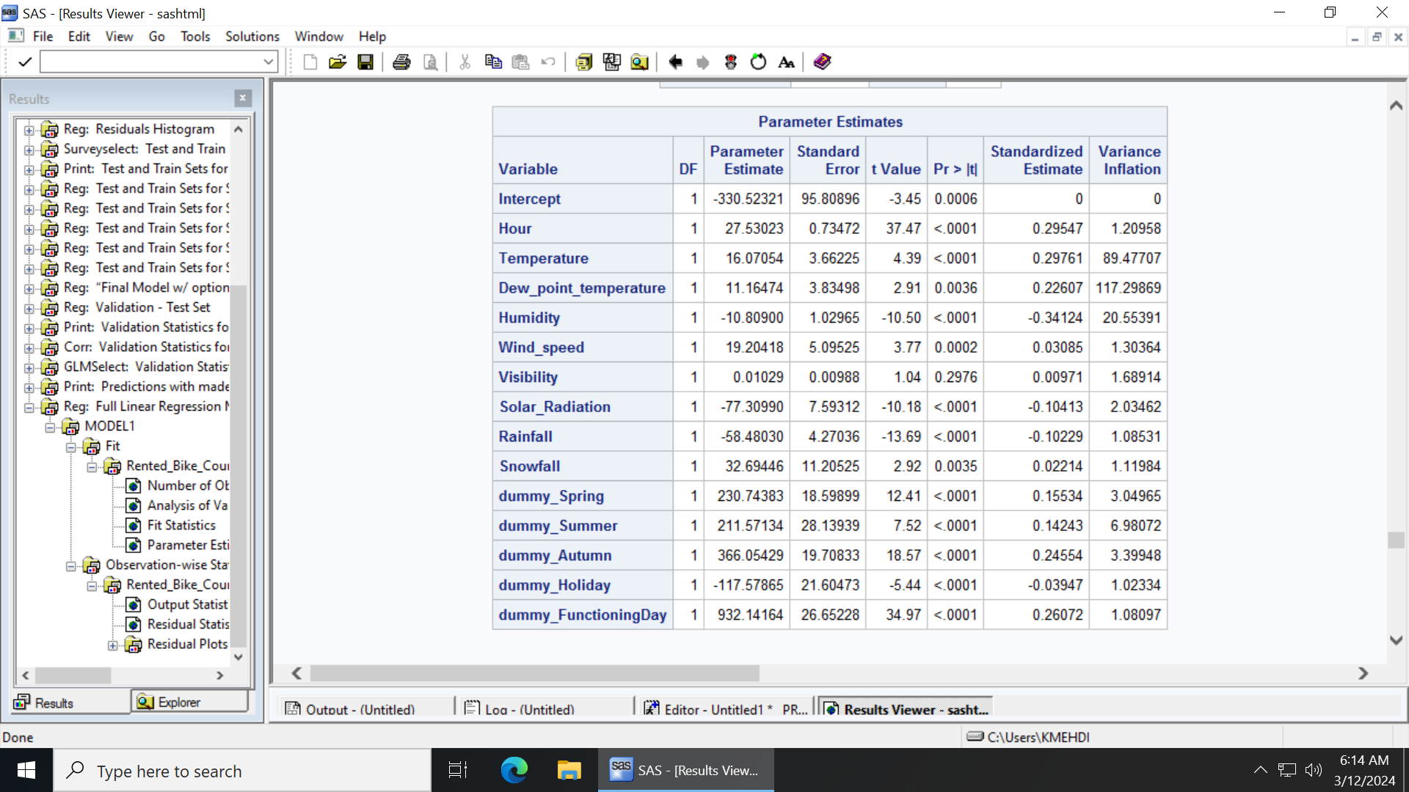
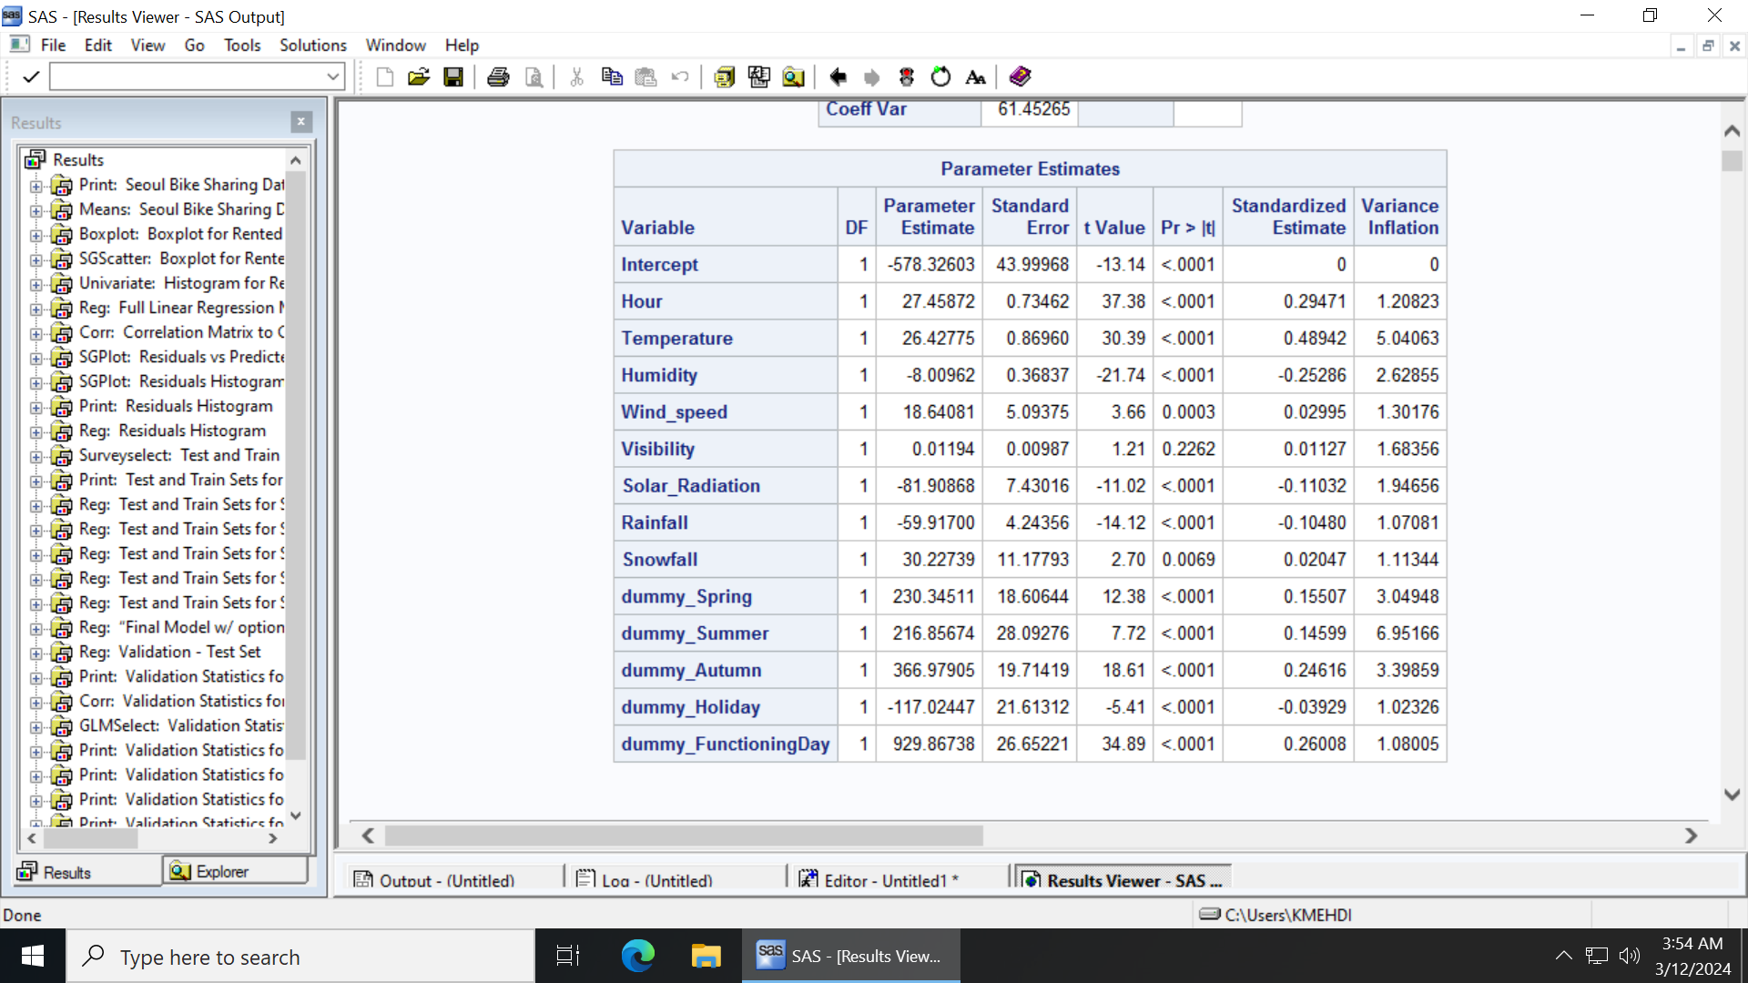
Model Building and Issues
A linear regression model was used, and dummy variables were made for the categorical variables Seasons, Holiday, and Functioning Day.
The initial model used all variables: Hour Temperature Humidity Wind_speed Dew_point_temperature Visibility Solar_Radiation Rainfall Snowfall dummy_Spring dummy_Summer dummy_Autumn dummy_Holiday dummy_FunctioningDay.
The vif values for humidity, temperature and dew point temperature were very high and had high multicollinearity, which makes sense as they are all weather conditions. Since the highest vif was 117 for dew point temperature it was removed. Removing it fixed all other vif values and made them less than 10. Adj r2 dropped to 0.5493 from 0.5497, which means removing dew point temp did not significantly reduce the model's ability to explain the variance in the rented bike count.
There were a lot of influential points and outliers, and after cleaning data and taking out outliers and influential point rows adj R^2 went up to 0.5832 from 0.5493.

Slide 6
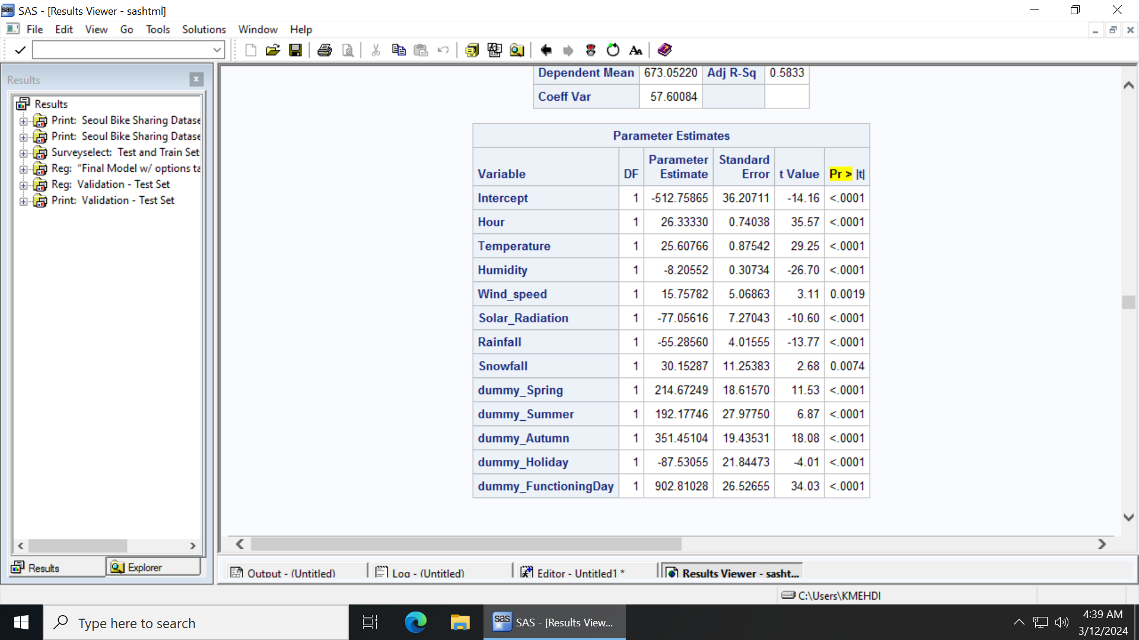
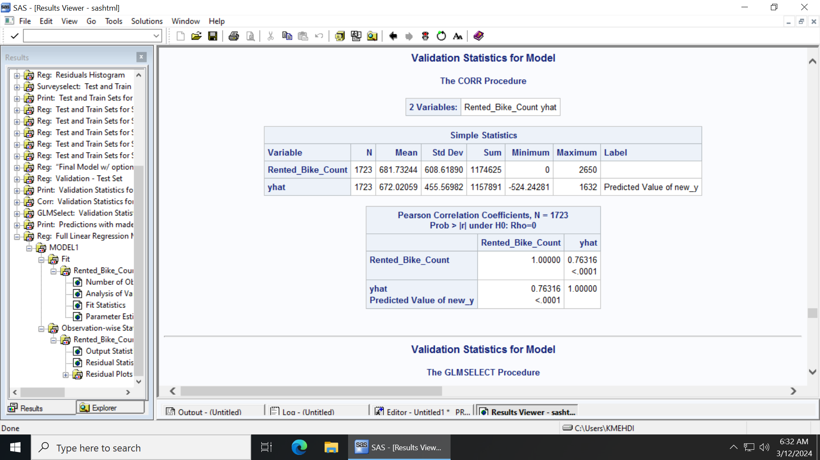
Selection Methods and Final Model building
Decided on stepwise selection method due to high R^2 value and less variables than cp and hence took out Visibility column for final model. When testing all the selection models, these were the R^2 values from each one: 0.5841 and 12 variables for cp, stepwise, and backward. 0.5841 for forward and 13 variables, and 0.5833 for Adjr2 and 12 variables.
Data was split into training and testing data using 80/20 split.
All variables are significant as their P-values were all less than the significance level P < .05.
The results show that the final model can be used to predict the number of Rented Bike Counts with about 58% accuracy, with a yhat value of 0.76316, the square of which gives us a R-Square of 0.58241.

Slide 7
Final Model Equation
new_y = -512.75865 + 26.33330 * Hour + 25.60766 * Temperature - 8.20552 * Humidity + 15.75782 * Wind_speed - 77.05616 * Solar_Radiation - 55.28560 * Rainfall + 30.15287 * Snowfall + 214.67249 * dummy_Spring + 192.17746 * dummy_Summer + 351.45104 * dummy_Autumn - 87.53055 * dummy_Holiday + 902.81028 * dummy_FunctioningDay

